Slide 1
6.（a）
(1110)₂ = 1×2³ + 1×2² + 1×2¹ + 0×2⁰
(in decimal) = 8 + 4 + 2 + 0
= (14)₁₀
6.（b）
(1010)₂ = 1×2³ + 0×2² + 1×2¹ + 0×2⁰
(in decimal) = 8 + 0 + 2 + 0
= (10)₁₀
6.（c）
(11100)₂ = 1×2⁴ + 1×2³ + 1×2² + 0×2¹ + 0×2⁰
(in decimal) = 16 + 8 + 4 + 0 + 0
= (28)₁₀

Slide 2
7.(b)
(101010.01)₂ = 1×2⁵ + 0×2⁴ + 1×2³ + 0×2² + 1×2¹ + 0×2⁰ + 0×2⁻¹ + 1×2⁻²
(in decimal) = 32 + 0 + 8 + 0 + 2 + 0 + 0 + ¼
= (42.25)₁₀
8.(g)
2⁸ - 1 = 255
10.(b)
8 through 15:
8 9 10 11 12 13 14 15 1000, 1001, 1010, 1011, 1100, 1101, 1110, 1111

Slide 3
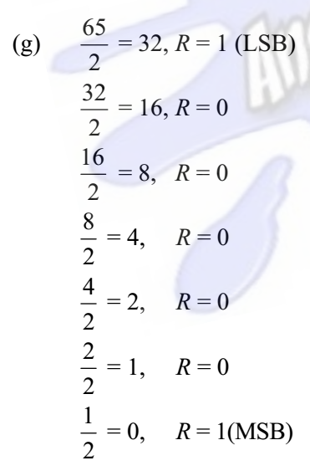
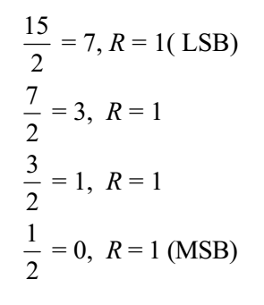
13.(a) 15
(15)₁₀ = (1111)₂
13.(g) 65
(65)₁₀ = (100 0001)₂

Slide 4
21.(e)
[N]_{r} = r^{n} - (N)_{r} r=2,n=7;
[111 0101]₂ = 2⁷-111 0101 = 000 1010
The 1’s complement of 111 0101 is 000 1010.
22.(a) 10
1) [N]_{r} = r^{n} - (N)_{r} 2)1’s complement +1
[10]₂ = 2²-10 = 10 01+1=10

Slide 5
22.(g) 1011 0000
1) [N]_{r} = r^{n} - (N)_{r}
[1011 0000]₂ = 2⁸-1011 0000 = 0101 0000
2)1’s complement +1
0100 1111 + 1 = 0101 0000
22.(h) 0011 1101
1) [N]_{r} = r^{n} - (N)_{r}
[0011 1101]₂ = 2⁸-0011 1101 = 1100 0011
2)1’s complement +1
1100 0010 + 1 = 1100 0011

Slide 6
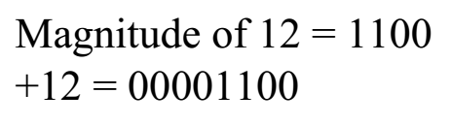
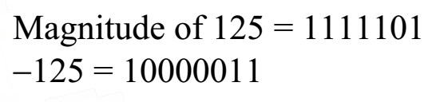
25.(a) +12 n=8
25.(d) -125 n=8
28.(b) 01110100
01110100 = +(1110100) = +116
28.(c) 10111111
10111111 = −(1000001) = −65

Slide 7
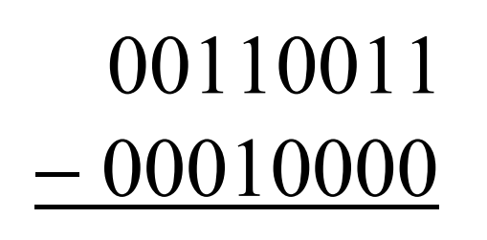
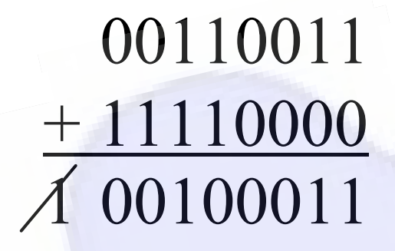
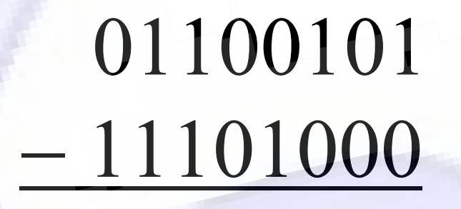
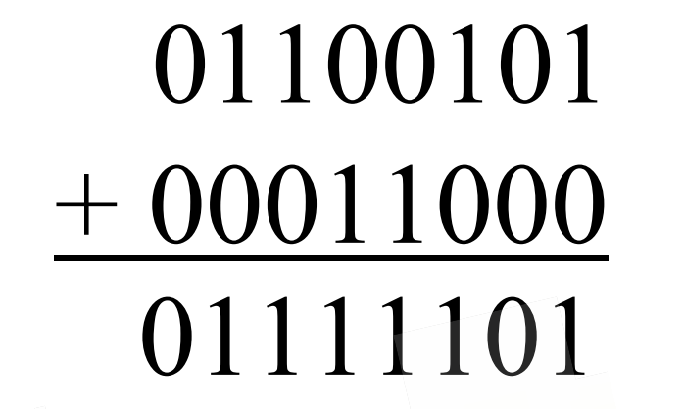
34.(a) 00110011-00010000
34.(b) 01100101-11101000

Slide 8
37.(g) 8A9D₁₆
8A9D₁₆ = 1000 1010 1001 1101
8 A 9 D
38.(f) 1001 1000 0010
1001 1000 0010 = 982₁₆
9 8 2

Slide 9
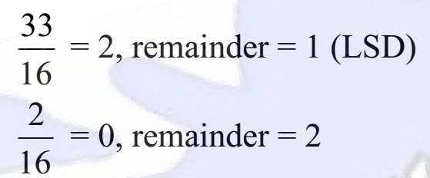
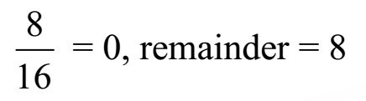
40.(a) 8
(8)₁₀ = (8)₁₆
40.(c) 33
(33)₁₀ = (21)₁₆

Slide 10
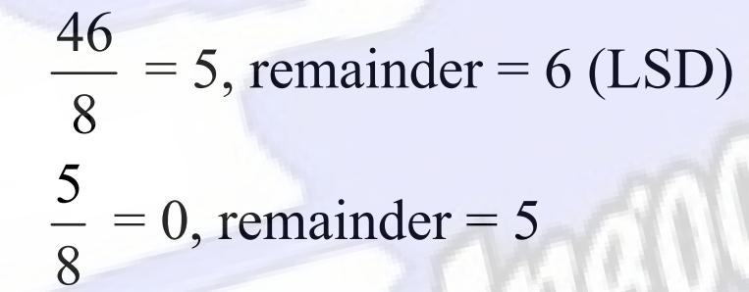
44.(c) 46
(46)₁₀ = (56)₈
45.(i) 8A9D₁₆
100213₈ = 001 000 000 010 001 011
1 0 0 2 1 3
46.(g) 101 100 011 001
101 100 011 001 = 5431₈
5 4 3 1
46.(h) 010 110 000 011
010 110 000 011 = 2603₈
2 6 0 3

